Slide 1
BOOKLOG
Prepared by:
Suman Asim
suman.asim@iu-study.org
M/N: 92126111
03-07-2023
Prepared for:
Prof. Dr. Sandra Rebholz
Project: Java and Web Development
DLBCSPJWD01
Project GitHub link:
https://github.com/SumanAsim22/booklog-web-project
PORTFOLIO PHASE 2

Slide 2
Table Of Contents
1 | Application Purpose
2 | Architecture Diagram
3 | Technology Overview
4 - 7 | Application Screenshots
8 | Changes from Proposal
9 | Application Screencast

Slide 3
Application Purpose
1
Booklog is designed to function as a book logging web application.
Its main purpose is to allow a user of the application to create and manage a book list on their device.
The interface provides the user with a book entry template to enter details of a book and search for a cover image, subsequently adding it to their list and modifying an entry as required.
The application can be utilized by readers to keep a log of their reading lists and to write down their thoughts and comments in a blog-like manner.

Slide 4
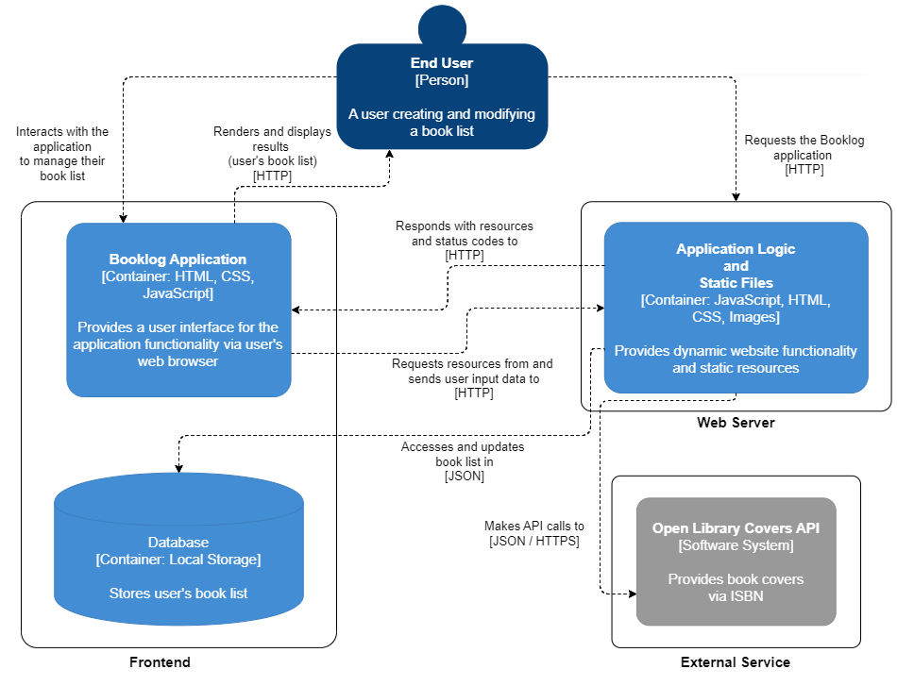
Architecture Diagram
2

Slide 5
Technology Overview
3
Frontend
HTML, CSS, and JavaScript are the building blocks of this web application project.
The responsibilities of each are application layout, styling, and functionality, respectively.
Together, they provide the user interface and the overall working of the application.
Data Storage
The client-side browser local storage has been employed for database operations.
The JavaScript code communicates with the localStorage object to store and retrieve the user’s book list.
External API
The application communicates with the Open Library Covers API to retrieve book cover images based on an ISBN input from the user.
No additional backend frameworks have been used.

Slide 6
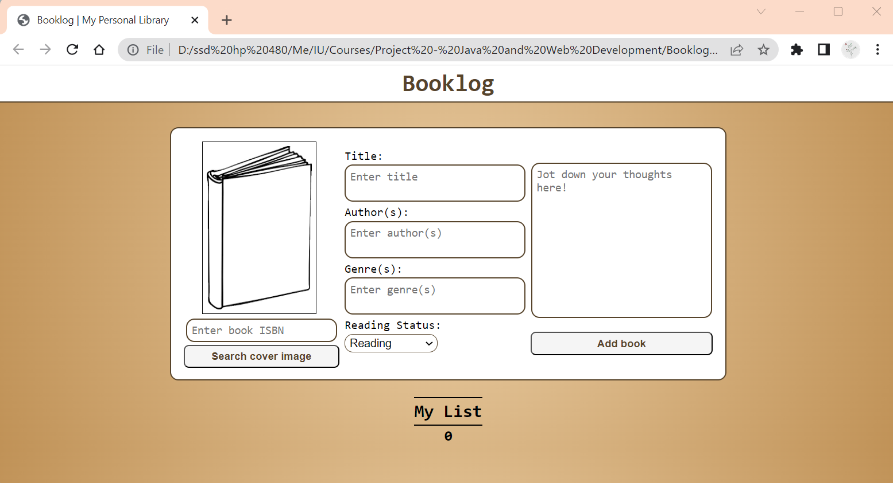
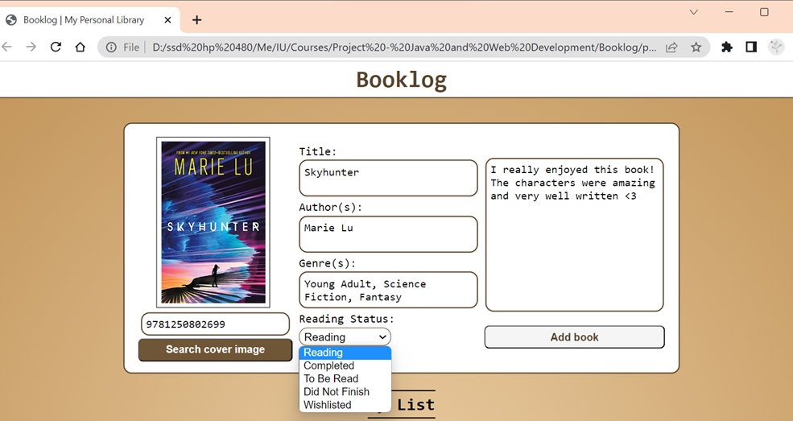

Application Screenshots
4
Default home page with empty book container
+
Empty list showing a book count of 0
Filling input fields to add book entry
+
Successful search result via ISBN input

Slide 7
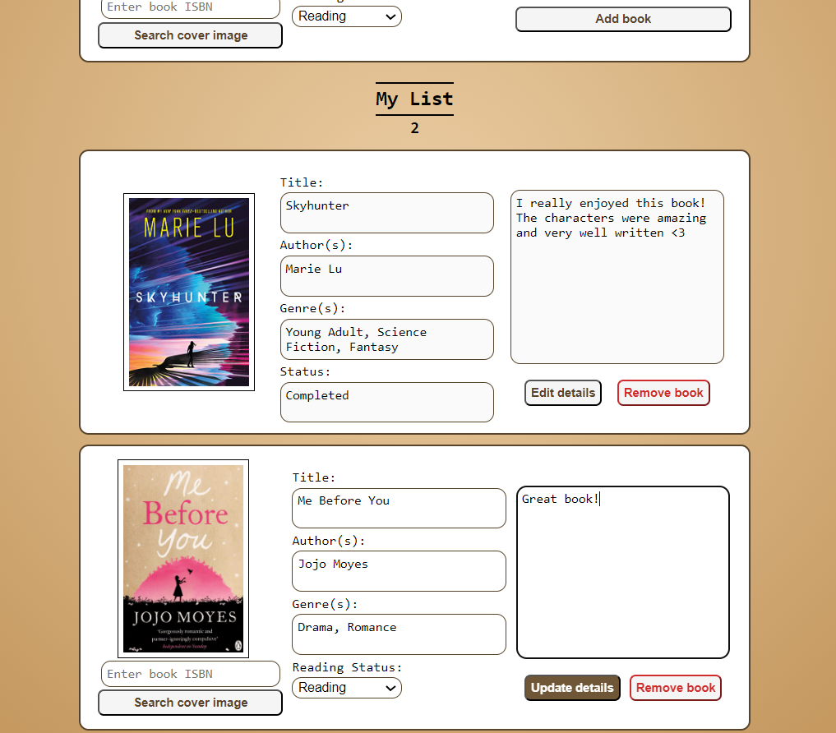
Application Screenshots
5
List with book entries added and updated book count
Each added book entry has edit and remove buttons
Edit button enables input areas and update button saves changes

Slide 8
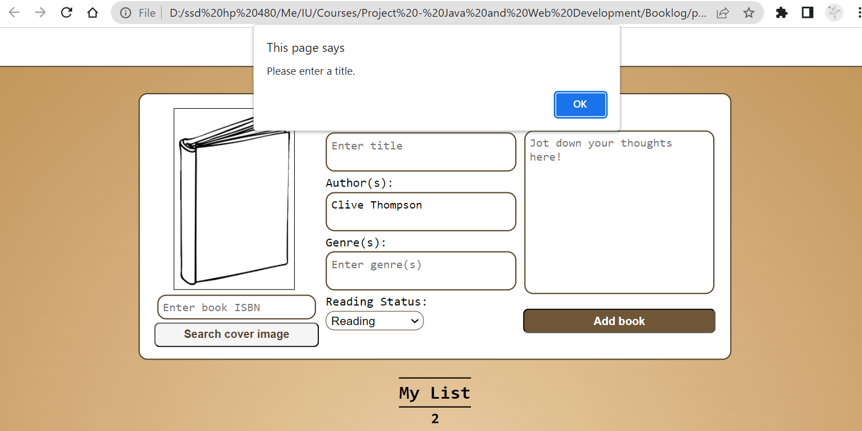
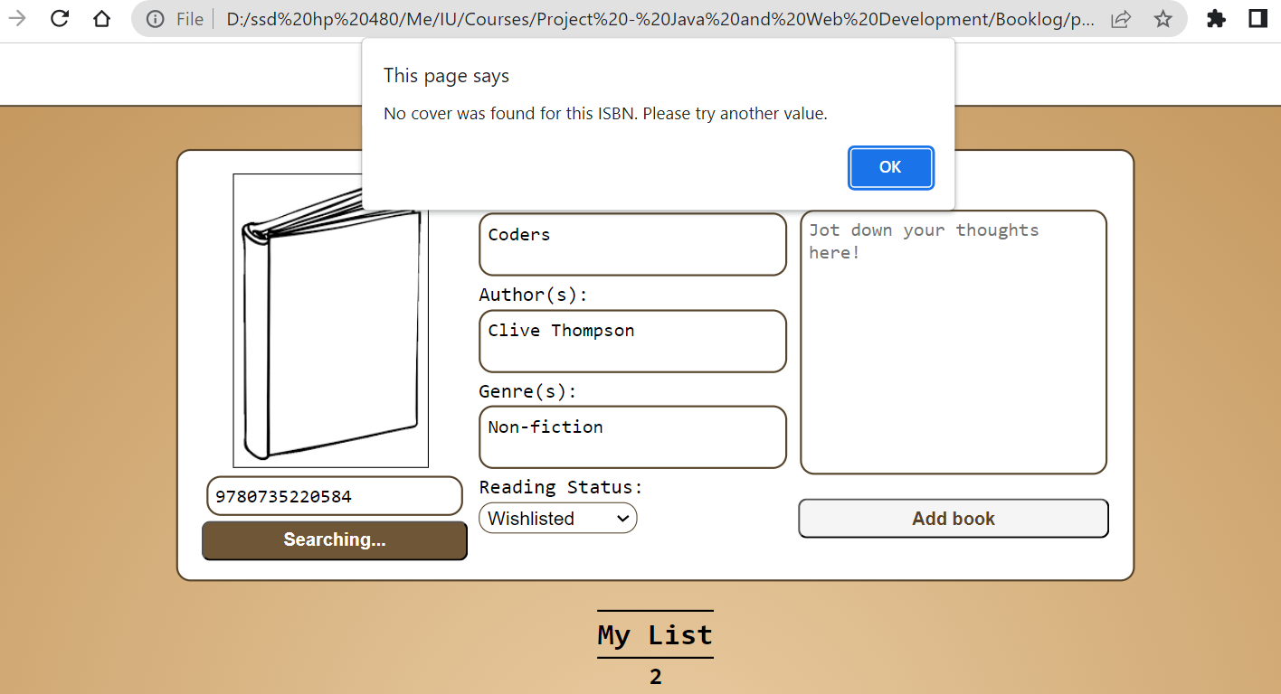
Application Screenshots
6
Alert generated for attempting to add book with empty title field
Alert generated for cover image not found
8

Slide 9
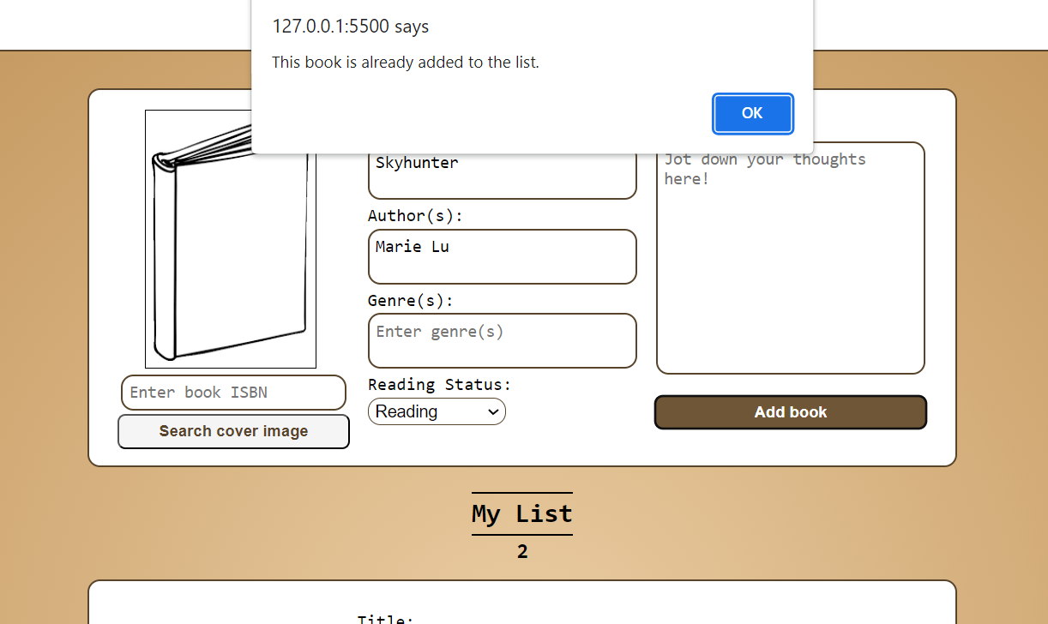
Application Screenshots
7
Alert generated for attempting to add book with duplicate title field and author
* No alert is generated if multiple books have the same title but different authors

Slide 10
Changes From Proposal
8
AREA OF CHANGE | Original | Change | Reason
FUNCTIONALITY | Searching for books and adding to a list | Creating book entries | To simplify the working of the application
USER ACCOUNTS | Users can create accounts and log in | User registration and login discarded | Basic application purpose does not require user accounts
DATABASE | MongoDB | Browser Local Storage | Local Storage allows for less complex storage and retrieval of data directly from JavaScript
EXTERNAL API | Open Library Search API | Open Library Covers API | Adapted according to functionality change; it allows the application to retrieve a cover image

Slide 11

Application Screencast
9

